Slide 1
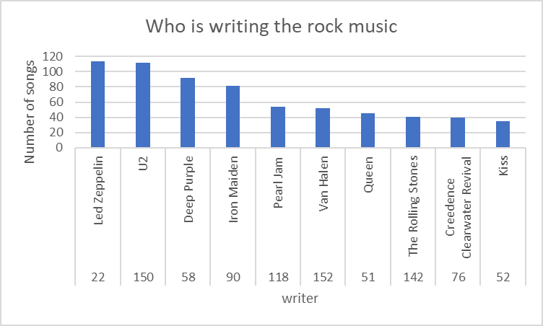
Who is writing the rock music
The arrange of the most writer ,write rock music

Slide 2
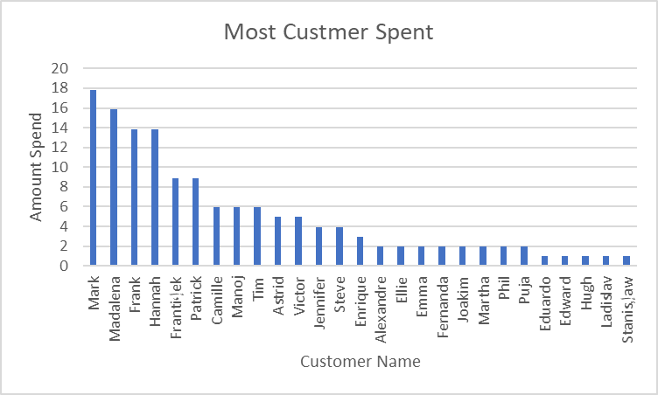
which artist has earned the most according to the InvoiceLines
artist has earned the most according to the InvoiceLines for Iron Maiden

Slide 3
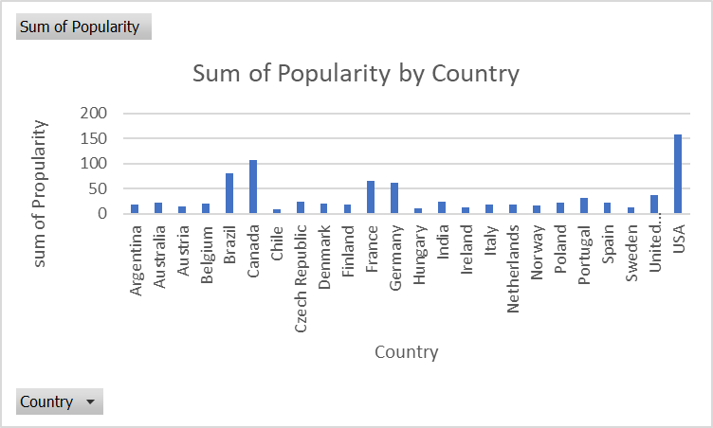
customer spent the most on music
query that determines the customer that has spent the most on music for each country

Slide 4
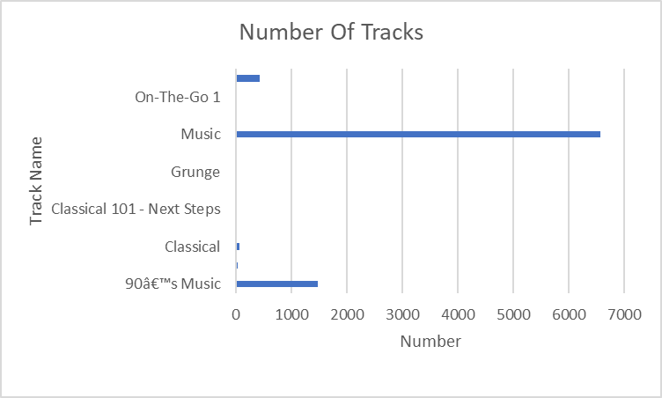
what is the number of track in each playlist
query that shows the total number of tracks in each playlist

